Slide 1
Presentation Draft
Leila Buchan, Alexandra Brown, Michael Zhao

Slide 2
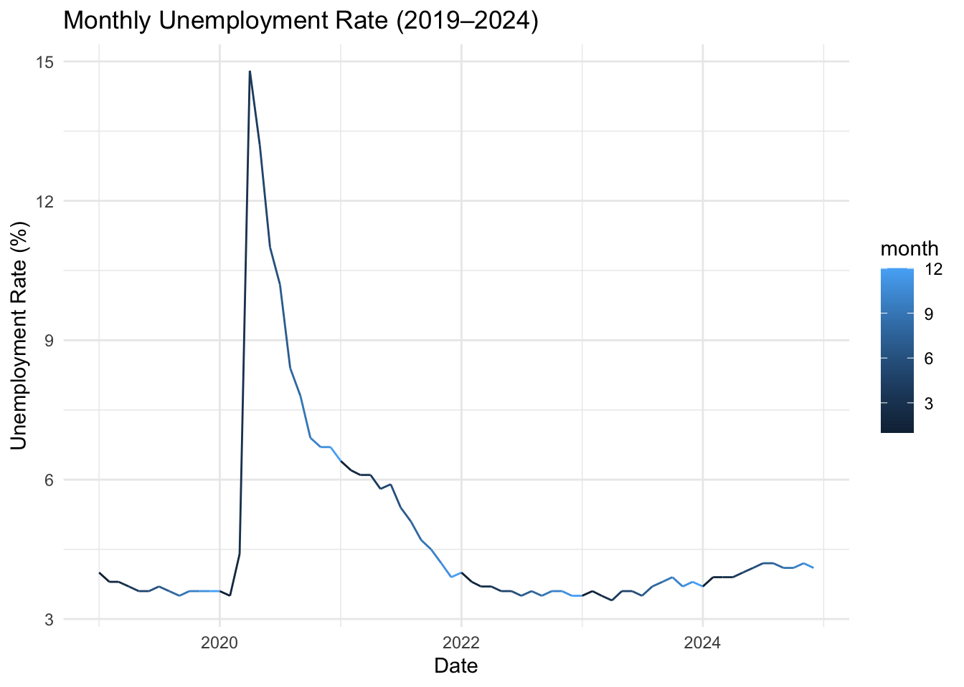
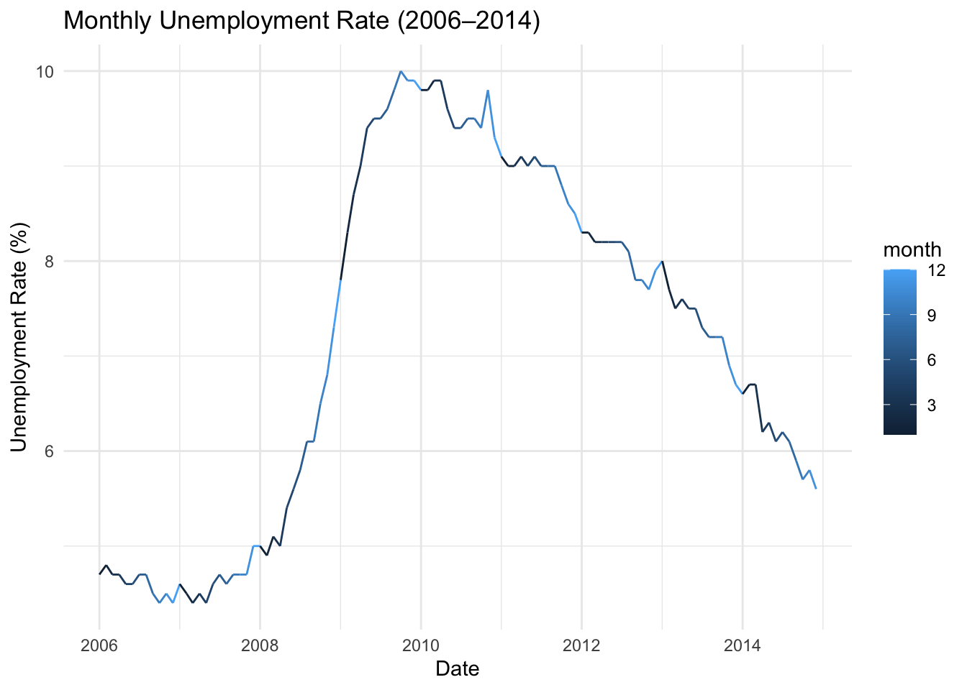
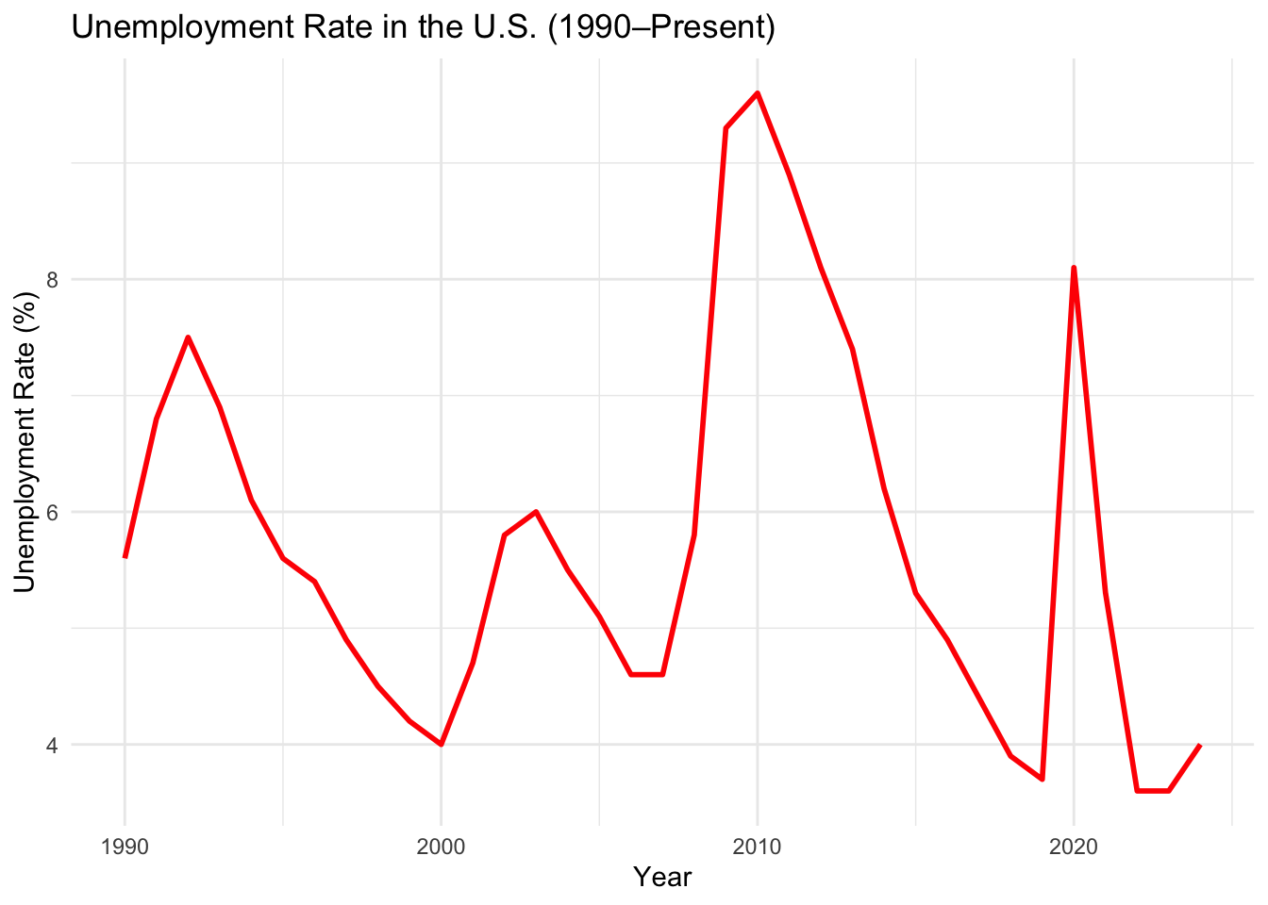
Examining Our EDA Code Notebook
Findings:
Cyclical Patterns Are Strong
Long Term Decline but Uneven Recovery
Further Goals:
How specific factors impact the rate. (State, Region, Occupation,and Gender)

Slide 3
Understanding Current Findings
Location Differences:
Internationally, differences are driven by job-finding
Domestically, differences are driven by job-loss
Occupational Differences:
ADD research on this
Drivers of Unemployment Rate
Job
Separation
Rate
Job
Finding
Rate

Slide 4
Needing More Conclusive Research
Research Questions
Disagreements whether it’s job-separation or job-finding rates
Limited research comparing unemployment across US regions
Limited research comparing unemployment across job-types
How do unemployment rates vary across states and regions?
Do different industries and occupations have different unemployment rates?
Are some regions and jobs more vulnerable to events?

Slide 5
Summarizing Our Datasets
LOCATION DATASET
State-based monthly unemployment data from January 1976-present
OCCUPATION DATASET
Job-based unemployment data from July 2025 and July 2024

Slide 6
Methods Slide
Data Cleaning and Processing: Removing metadata rows and standardizing column names. Converting year and month columns into a standard form of date. Filtering for specific months and aggregating by U.S. Census regions where necessary.
Visualization:Time Series Line Plot, State-Level Heatmaps, Bar Charts

Slide 7
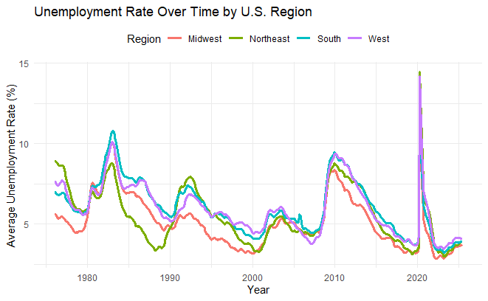
Unemployment Rate Over Time by US region
The chart shows the average unemployment rate across U.S. regions. From the graph, while all regions experienced the same trend during COVID-19 and other recessions, the West and South experienced the most dramatic increases during these periods, while the Midwest generally maintained lower unemployment rates.
Notes:
This slide displays the relationship between unemployment overtime by each US region. The x-axis represents the year and the y-axis represents the reported unemployment rate. There are multiple lines graphs, each line is colored differently to show how a specific regions unemployment rate fluctuates over time. The legend indicates which color corresponds with which region. Across all regions, there are generally a similar trends of when unemployment peaks and troughs. But we can see slight differences, such as in during the COVID-19 pandemic where the West (purple line) has a way greater unemployment rate that year.

Slide 8
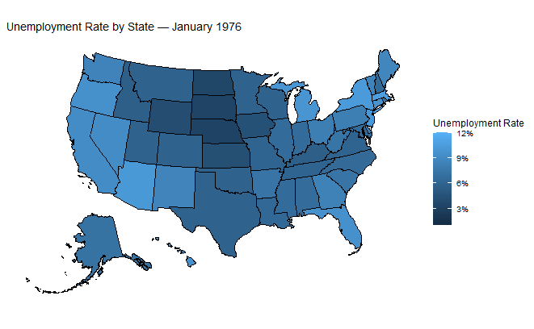
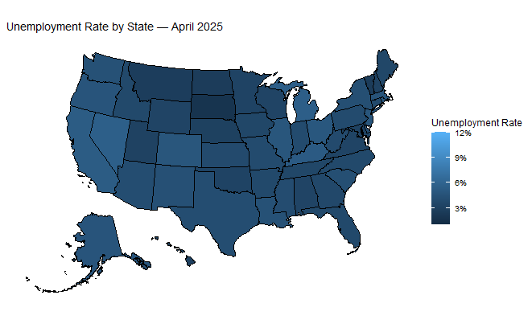
Heatmap of Unemployment Rate by State
The two maps compare each state’s unemployment rates in January 1976 and April 2025. Overall, the unemployment rate was higher back in 1976. In both periods, states in the South and parts of the Midwest tend to show higher unemployment rates compared to the Northeast and West regions.
Notes:
This slide shows two heatmaps comparing January 1976 unemployment rate data to April 2025 unemployment rate data. The lighter the shade of blue a state is filled in with, the higher their unemployment rate is. In general, the unemployment rate was greater in 1976 compared to present. There was also more differences in unemployment rates across states in 1976 compared to present. In both time periods, the South and parts of Midwest have higher unemployment rates compared to Northeast and West.

Slide 9
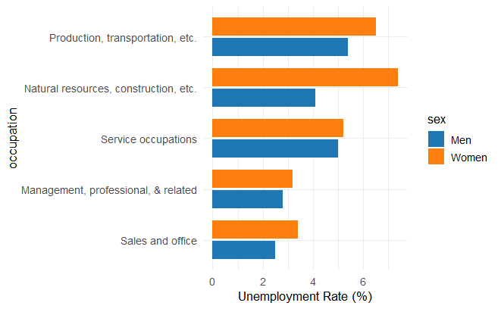
Bar Graph of Unemployment Rate by Occupation and Gender
From the plot, for all occupations, women experience a higher unemployment rate compared to men. Production, transportation, and related occupations show the highest unemployment, followed closely by natural resources, construction, and maintenance. Service occupations also have relatively high rates, indicating more job instability in these sectors. In contrast, management, professional, and related occupations and sales and office roles report the lowest unemployment rates. Overall, jobs related to physical labor are more unstable compared to others.
Unemployment Rate by Occupation and Gender
Notes:
The x-axis shows the unemployment rate and they-axis labels what type of occupation. For each occupation there are two bars, with blue=men and orange=women. Across all occupations, women experiences a higher unemployment rate compared to their male counterparts. The difference between genders is highlighted most in the natural resources, construction occupation sector. This also reports the highest overall unemployment rate (above `6%). This contrasts greatly with the management, professional & related occupation which has closest to even unemployment rates between genders and the lowest overall unemployment rate.

Slide 10
CONCLUSION? OR GENERAL ANALYSIS?

